Slide 1

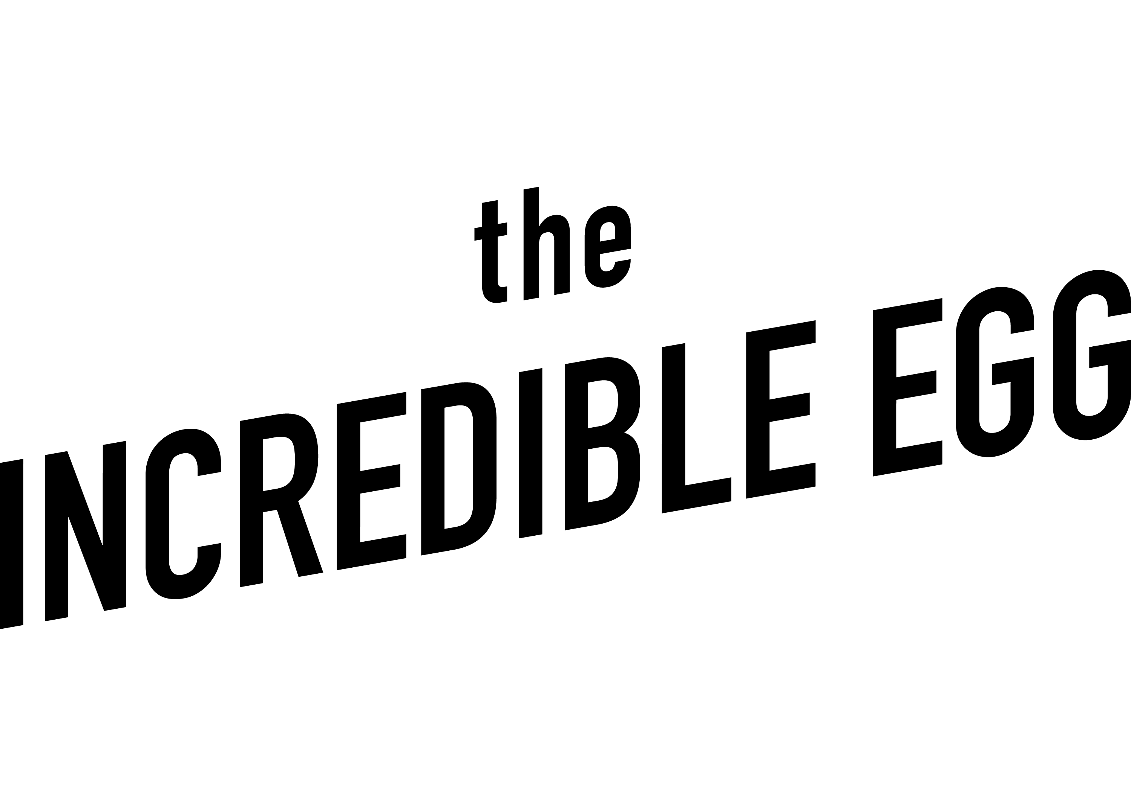
Eggs are Healthy
Content
Spring 2025

Slide 2

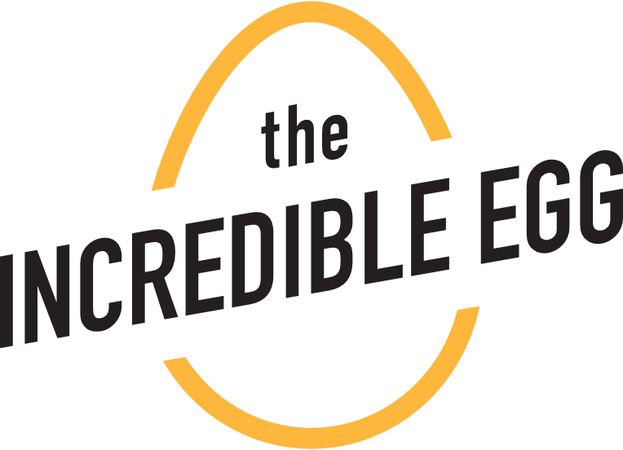
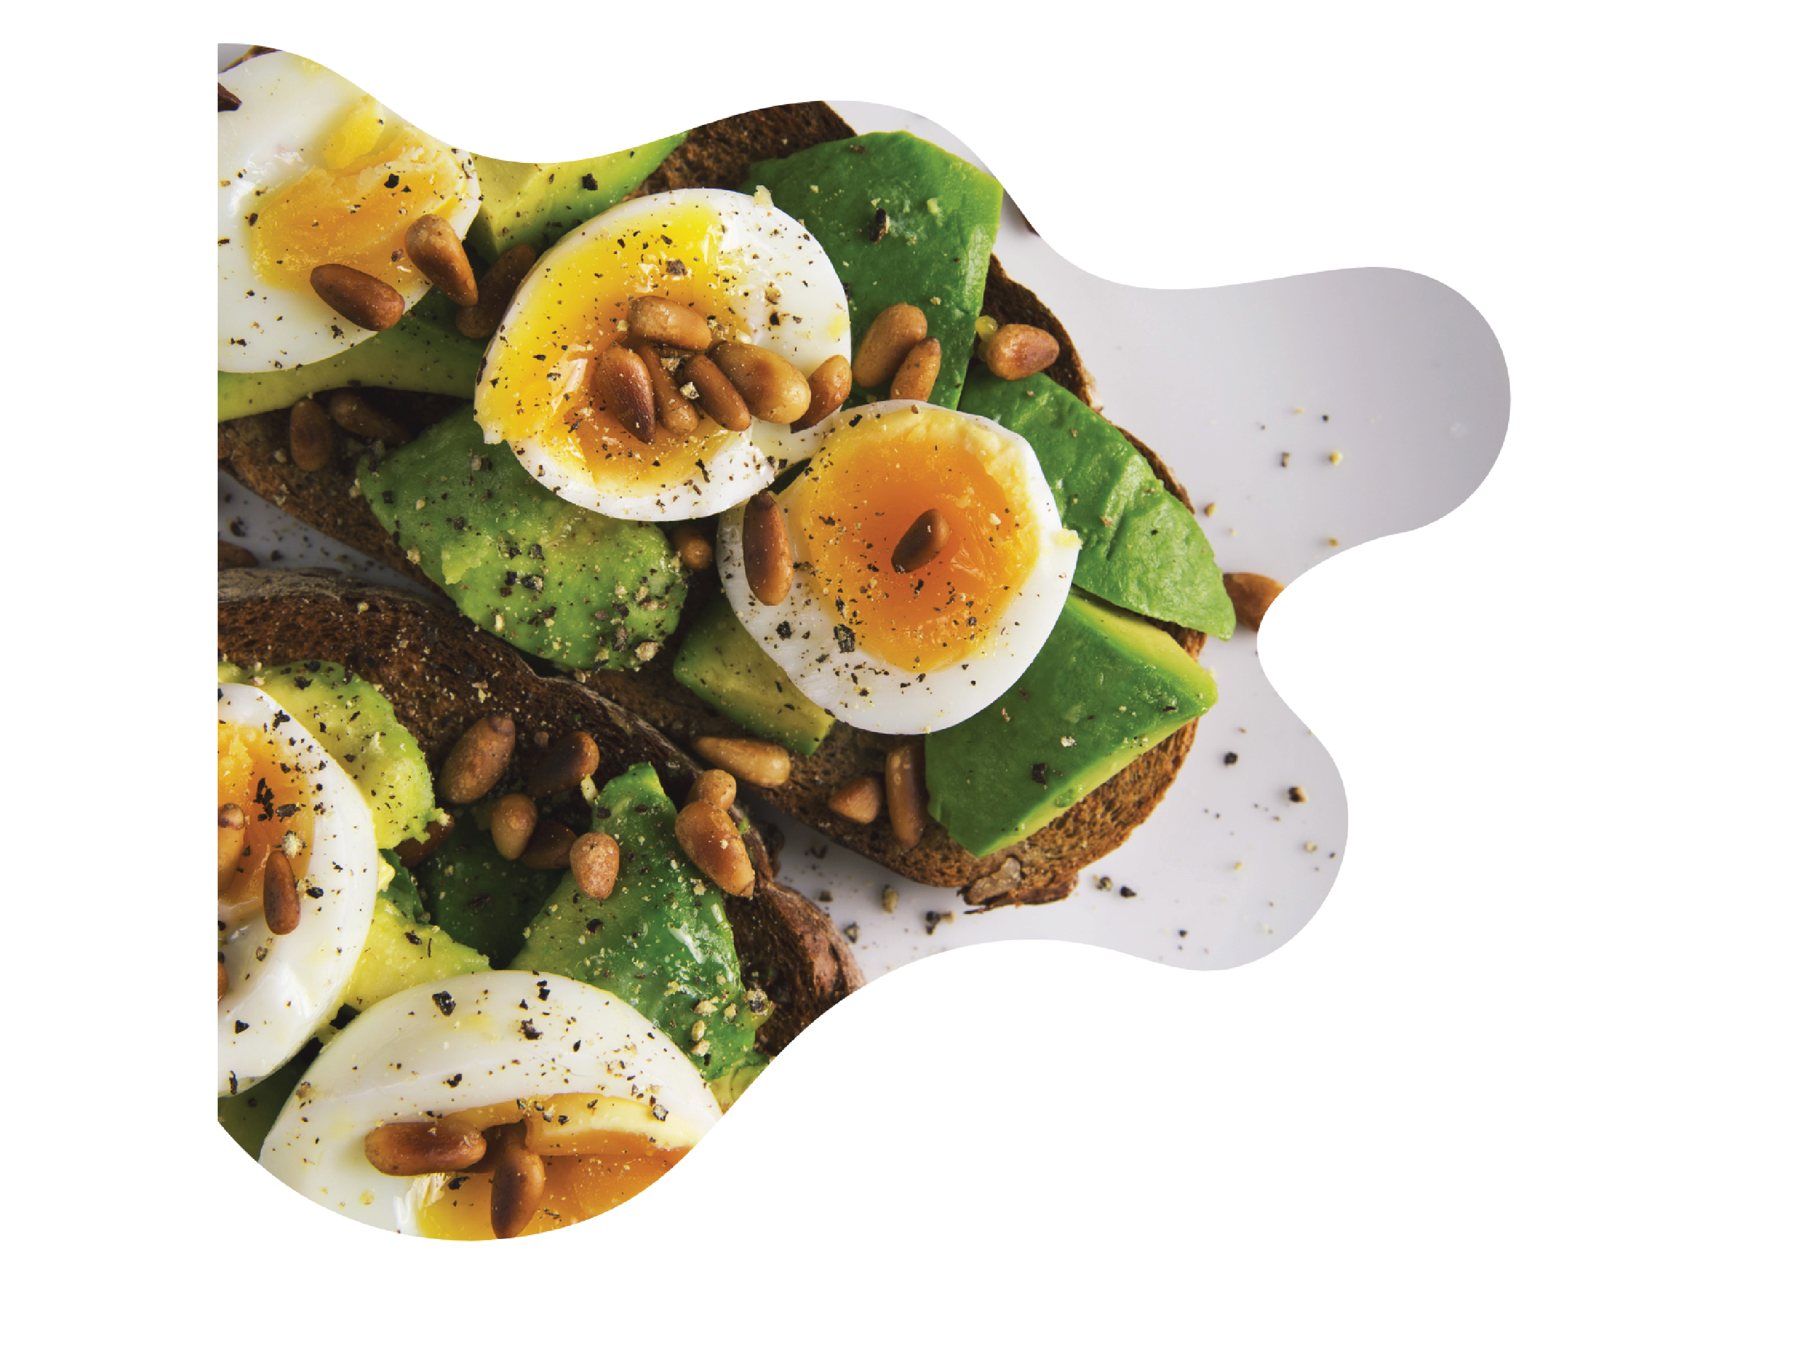
Social Media
Posts

Slide 3

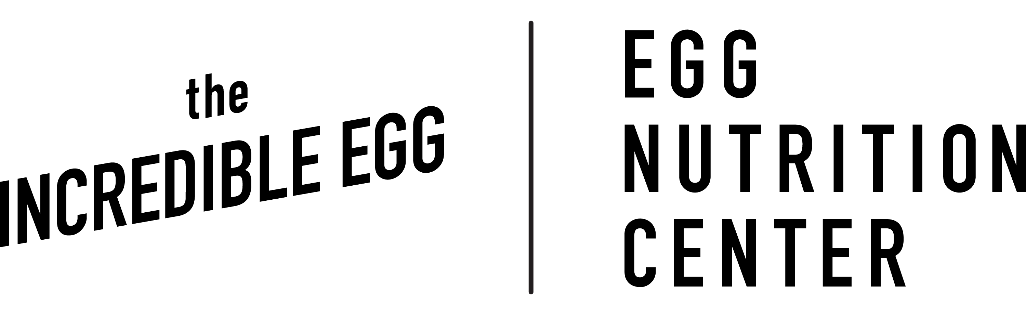
Eggs are Healthy Social Media
This toolkit provides ready-to-use, USDA-approved social media copy and suggested graphics written to suit Meta platforms. It has been reviewed and approved by USDA, and the body copy should not be changed.
You can simply copy the text on the following slides and paste it into the respective platform or your scheduling tool of choice. The associated graphics on each slide are available in the visual asset folder linked here.
We have included links to IE.org. Please feel free to replace this link with your own web address.
For any questions or concerns, please email: Katie Hayes at KHayes@eggnutritioncenter.org

Slide 4


Announcement Post
Facebook Instagram | Eggs are healthy! The Food and Drug Administration (FDA) confirms that eggs meet the agency’s updated definition of "healthy." 🥳 Let’s crack into why eggs are a nutritional powerhouse: 🥚 They contain an excellent or good source of eight essential nutrients that support health at every age 🥚 Eggs are particularly known for being one of the highest-quality proteins available, playing a vital role in muscle health and overall wellness. 🥚 Research suggests eggs can enhance the absorption of nutrients from vegetables, making them a perfect partner for healthy eating [FOR INSTAGRAM] Check out the #LinkinBio to learn more about how to incorporate eggs into your healthy meals. [FOR FACEBOOK] For more on how to incorporate eggs into your healthy meals, check out: [Insert link to Eggs Are Healthy landing page] Both linked to: https://www.incredibleegg.org/nutrition/eggs-are-healthy/ #EggsAreHealthy #HealthyEating #IncredibleEgg
This is the suggested image for this social post. It is available in the visual asset folder linked here.

Slide 5
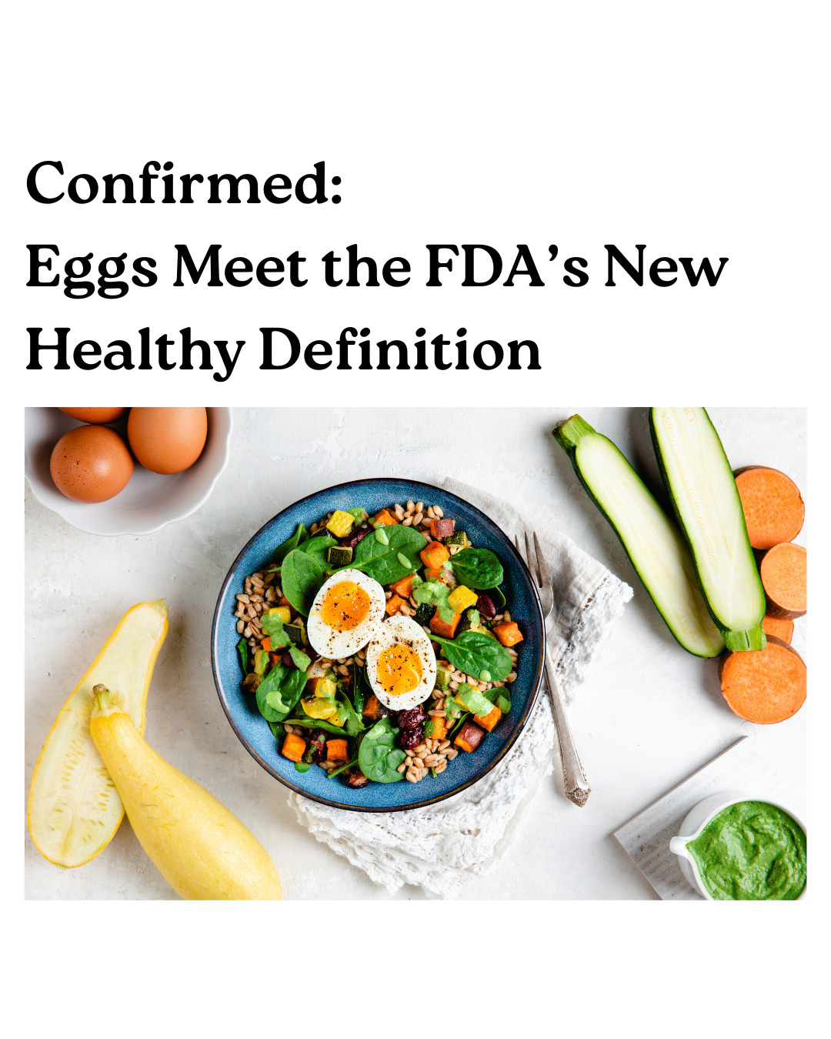
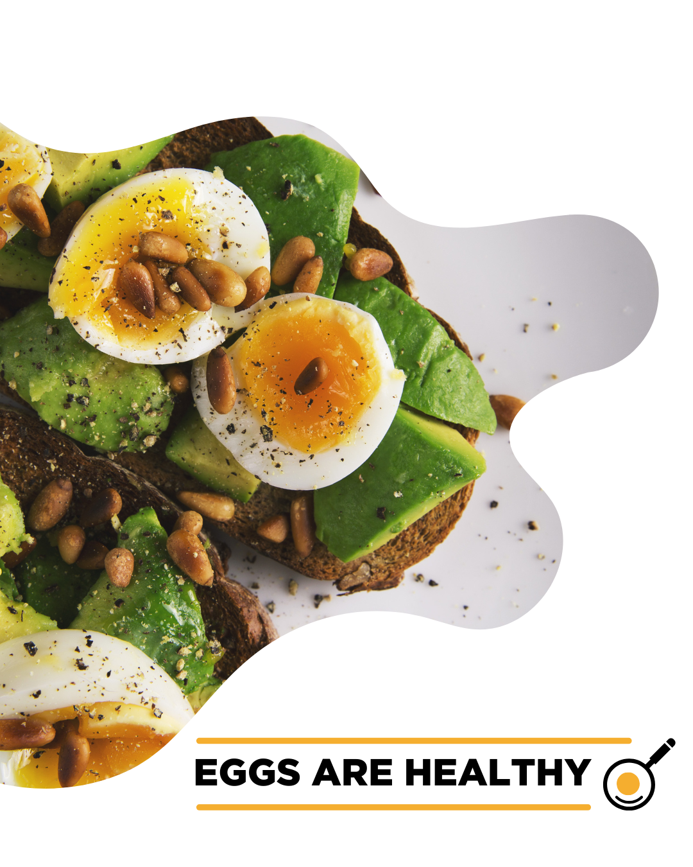
Eggs Belong on Your Plate
Facebook Instagram | 🥚Eggs = Officially Healthy! 🥚 The FDA updated its definition of “healthy” and eggs make the list! Versatile, nutritious, and now FDA-approved as healthy! Here’s why they belong on your plate: ✅ Eggs are a healthy, nutrient-rich food ✅ Eggs are versatile and convenient to build tasty and healthy meals ✅ Eggs are one of nature’s most perfect proteins ✅ Eggs have choline that helps support lifelong brain health [FOR INSTAGRAM] Check out the #LinkinBio to learn more about how to incorporate eggs into your healthy meals. [FOR FACEBOOK] For more on how to incorporate eggs into your healthy meals, check out: [Insert link to Eggs Are Healthy landing page] Both linked to: https://www.incredibleegg.org/nutrition/eggs-are-healthy/ #EggsAreHealthy #HealthyEating #IncredibleEgg
These are suggested images for this social post. They are available in the visual asset folder linked here.

Slide 6
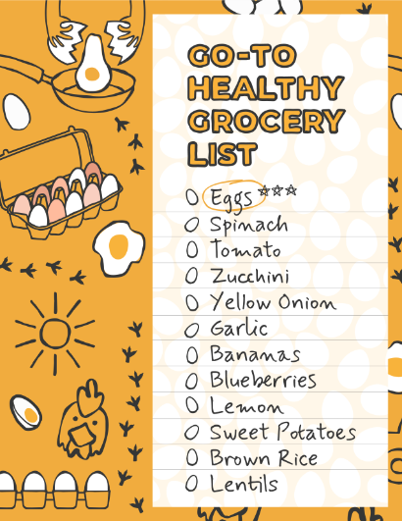
Grocery List
Facebook Instagram | Not only does the FDA’s “healthy food” definition help you meet your nutritional needs, but it also puts eggs in good company with fruits and vegetables on the FDA’s healthy foods list. 🥚🍓🥦 Now you can feel better than ever about reaching for that carton, while we continue our efforts to ensure a steady supply of fresh, versatile and healthy eggs! #EggsAreHealthy #HealthyEating #IncredibleEgg
This is the suggested image for this social post. It is available in the visual asset folder linked here.

Slide 7
What Makes Eggs Healthy?
Facebook Instagram | It’s no secret that #eggs are healthy. Recently, the Food and Drug Administration (FDA) confirmed: eggs, often celebrated for their simplicity, versatility and nutrition, can now proudly wear the “healthy” badge. Let’s run down some highlights: Eggs make healthy eating quick and simple, offering high-quality protein, vitamins and minerals.🎉 Eggs are also rich in choline, a nutrient that helps support lifelong brain health at every age and stage, including memory, thinking, mood and more. [FOR INSTAGRAM] The list of nutritional benefits goes on, so check out the #LinkinBio to learn more! [FOR FACEBOOK] The list of nutritional benefits goes on, so check out [Insert link to Eggs Are Healthy landing page] Both linked to: https://www.incredibleegg.org/nutrition/eggs-are-healthy/
See graphics for carousel post on the next page

Slide 8
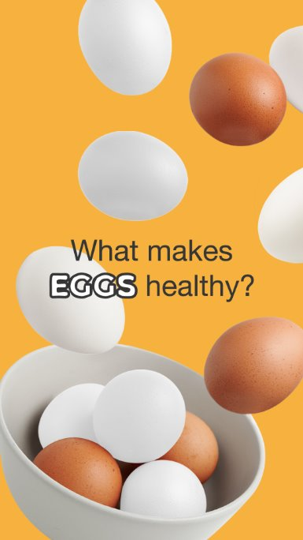
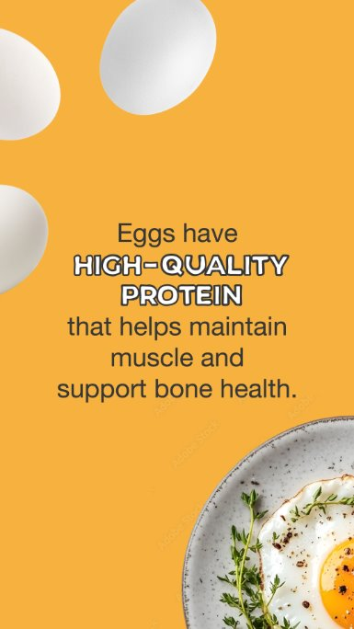
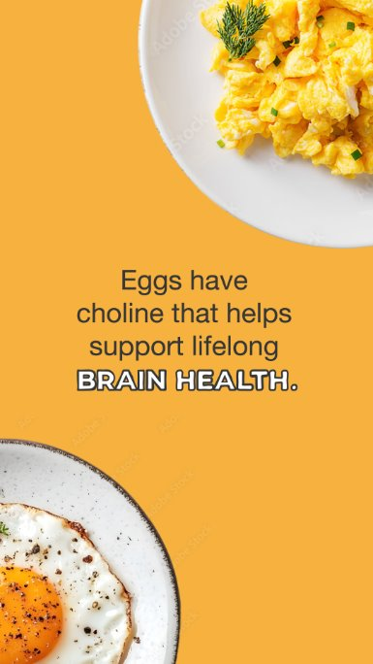
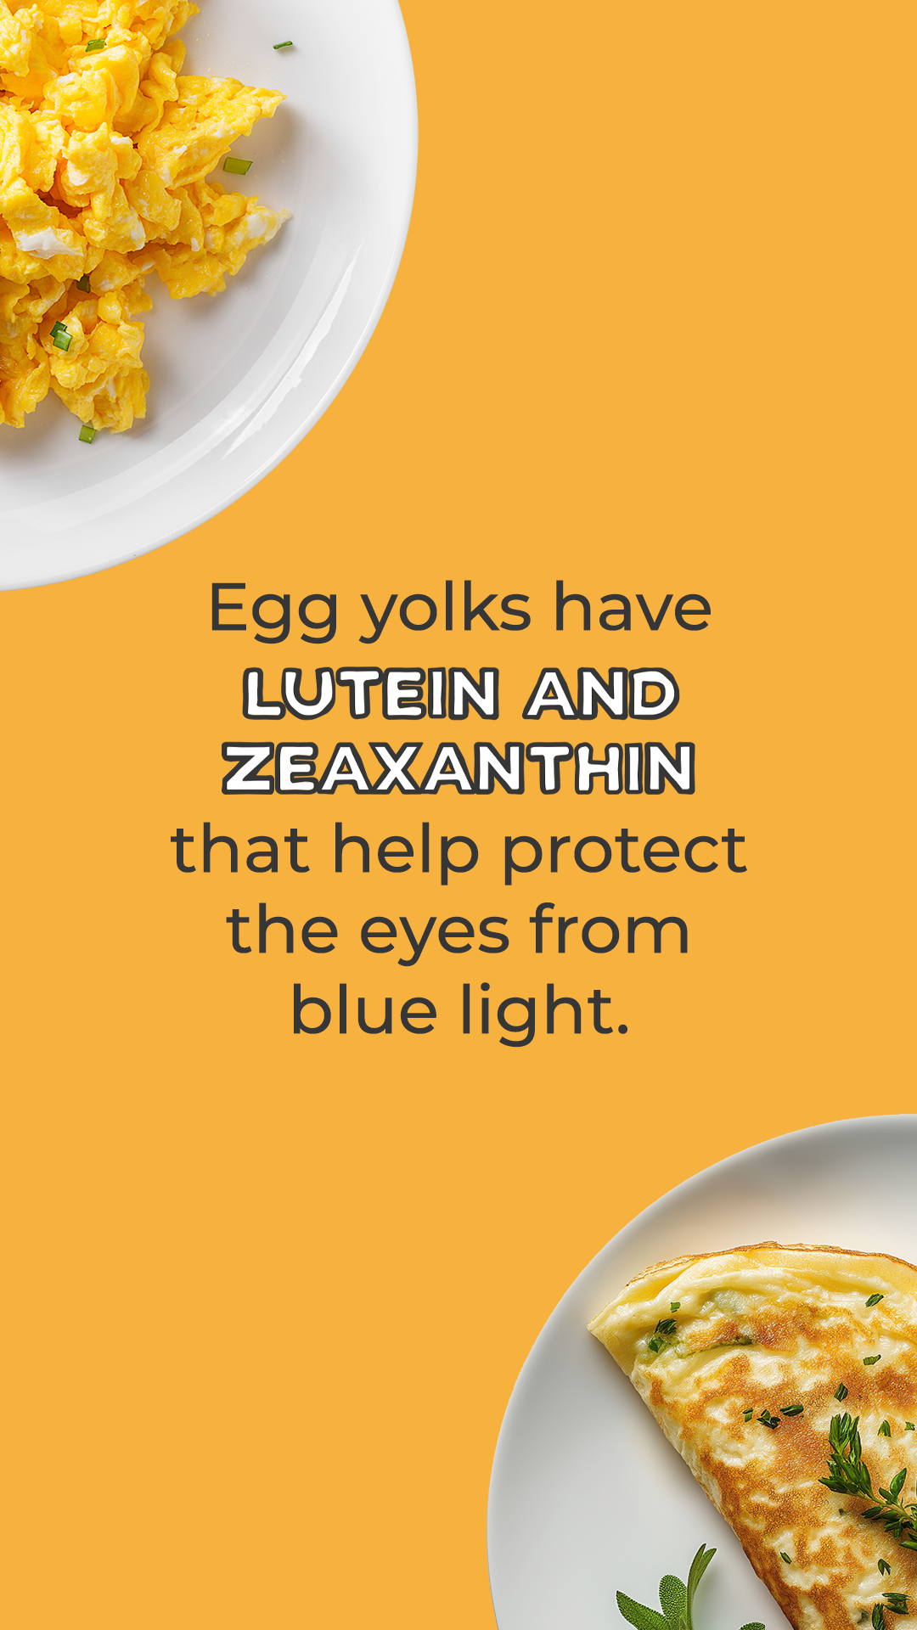
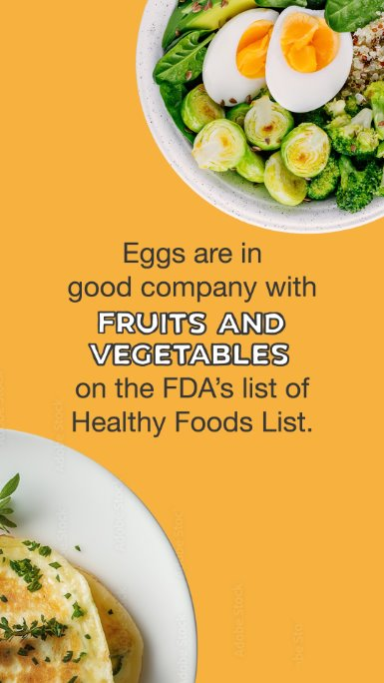
Graphics for Copy on Previous Slide
These are suggested images for this social post. They are available in the visual asset folder linked here.

Slide 9

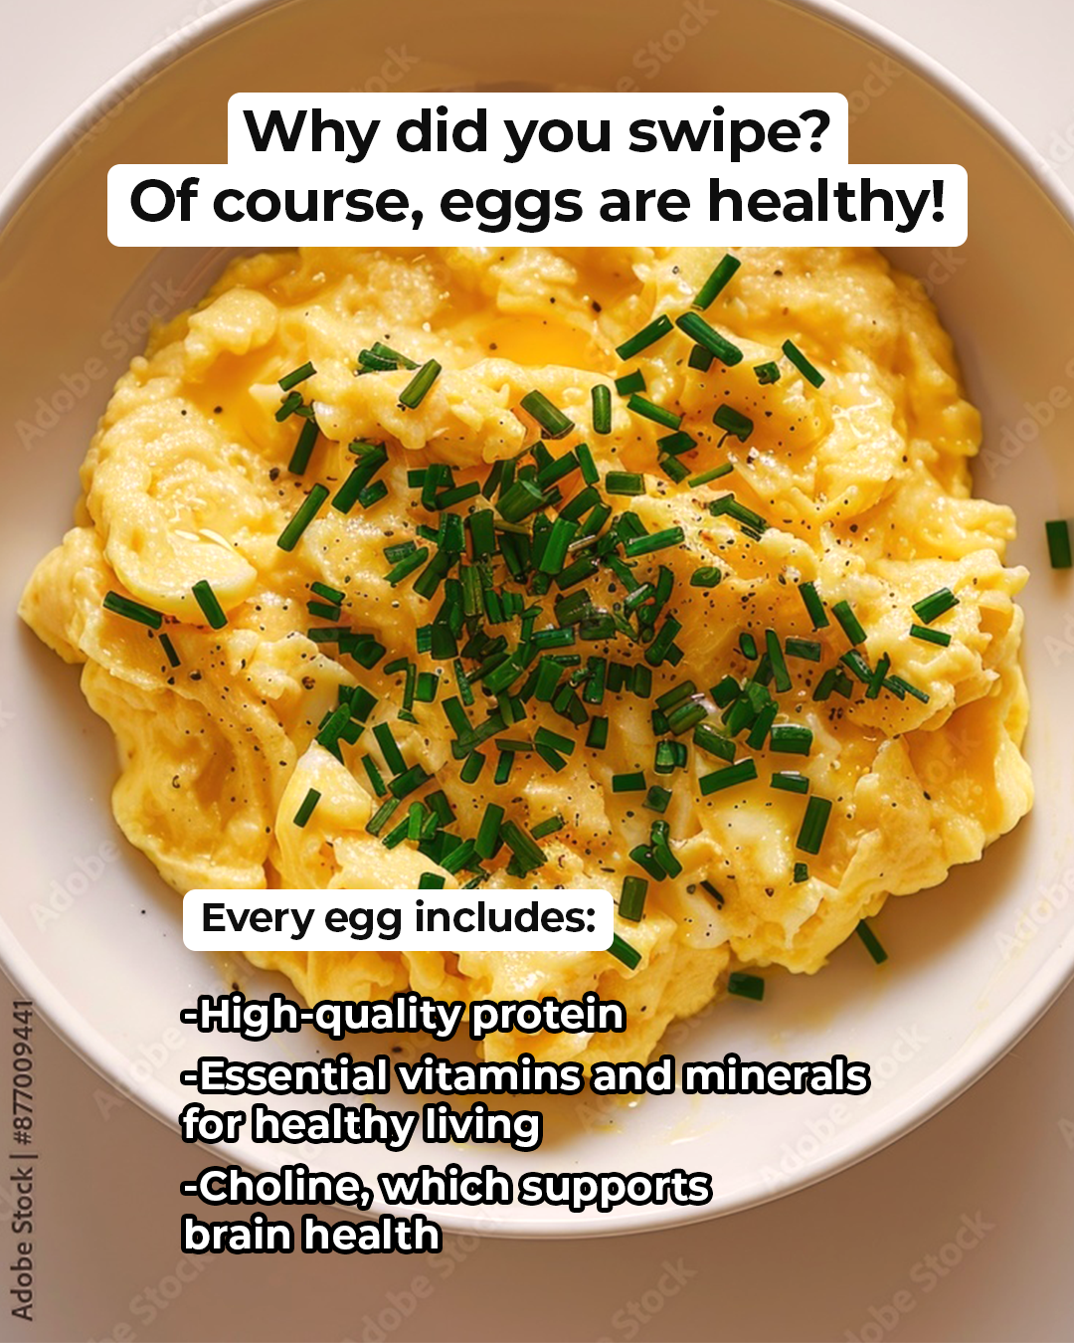

Trend-Driven Reels/TikTok Posts
Facebook Instagram TikTok | However you make them, you can count on them to fuel your body. ✨ #EggTok For food safety, always ensure eggs are cooked to 160 F.
Assets for this post are available in the visual asset folder linked here.

Slide 10
Website
Copy

Slide 11
Eggs are Healthy Website Copy
Eggs Officially Recognized as “Healthy” by the FDA
Big news: Eggs now meet the FDA’s updated definition of “healthy!” Backed by decades of research, this new recognition confirms what the science has long supported—eggs are a healthy and versatile choice to make healthy eating simple for you and your family.
For only 70 calories, eggs are an excellent or good source of eight essential nutrients, making them a perfect complement to any eating pattern, including Mediterranean, low-carb, and plant-based. Plus, eggs deliver key nutrients that most Americans don’t get enough of – such as choline, which supports lifelong brain health from conception to all ages and stages. In fact, a new study published in The Journal of Nutrition found a relationship between eating eggs and a reduced risk of Alzheimer’s dementia in older adults, a relationship driven by dietary choline.
So, hard-boil, poach, and scramble with confidence—eggs are officially healthy.

Slide 12
Eggs are Healthy Website Copy - Shorten
Shortened Version
Eggs Officially Recognized as “Healthy” by the FDA
Big news: Eggs now meet the FDA’s updated definition of “healthy!” Backed by decades of research, this new recognition confirms what the science has long supported—eggs are a healthy and versatile choice to make healthy eating simple for you and your family.
So, hard-boil, poach, and scramble with confidence—eggs are officially healthy.

Slide 13
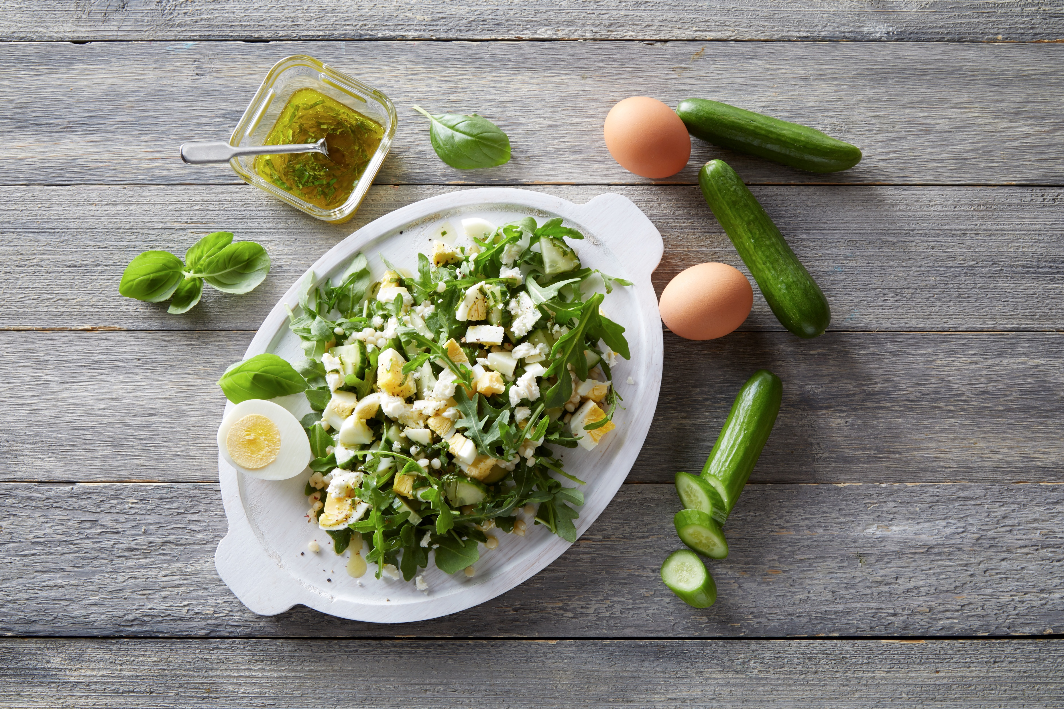

Eggs are Healthy Website Photos
These are the suggested website images. They are available in the visual asset folder linked here.

Slide 14
Retailer
Resources
All the following retailer resources are available in the folder linked here.

Slide 15

Resources to Share with Retailers
Sample Letter to
Share with Retailers

Slide 16
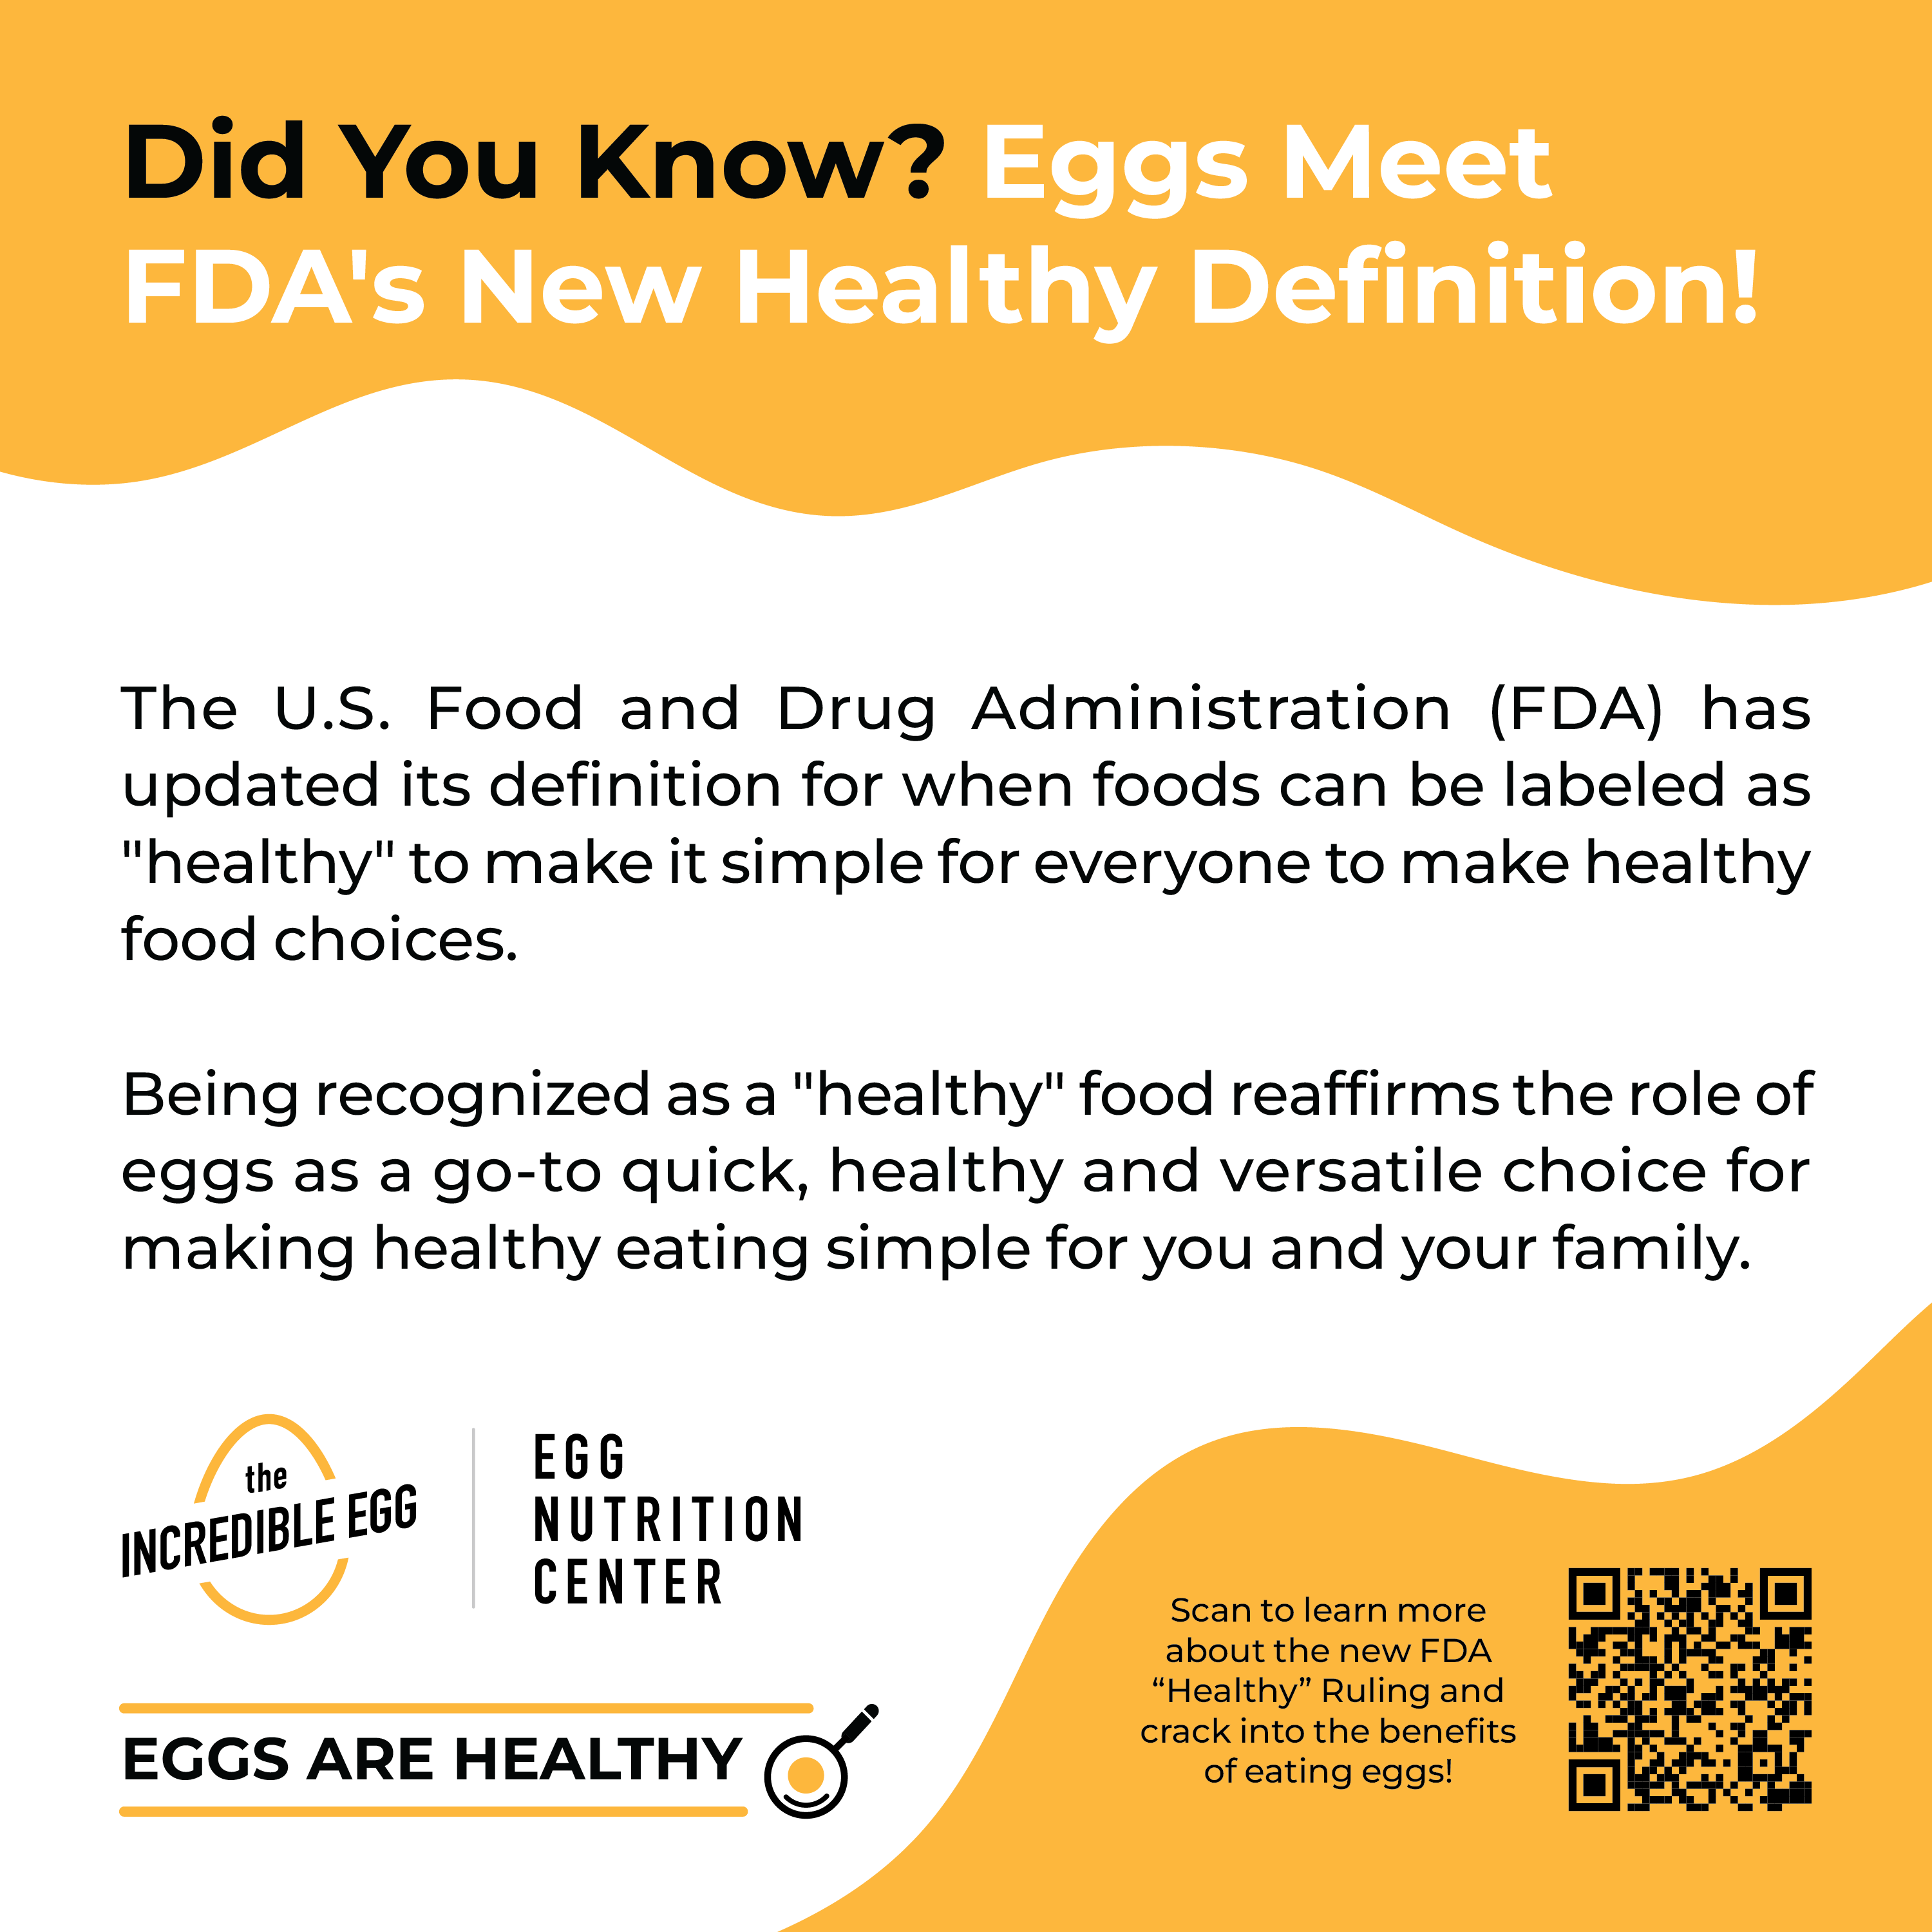
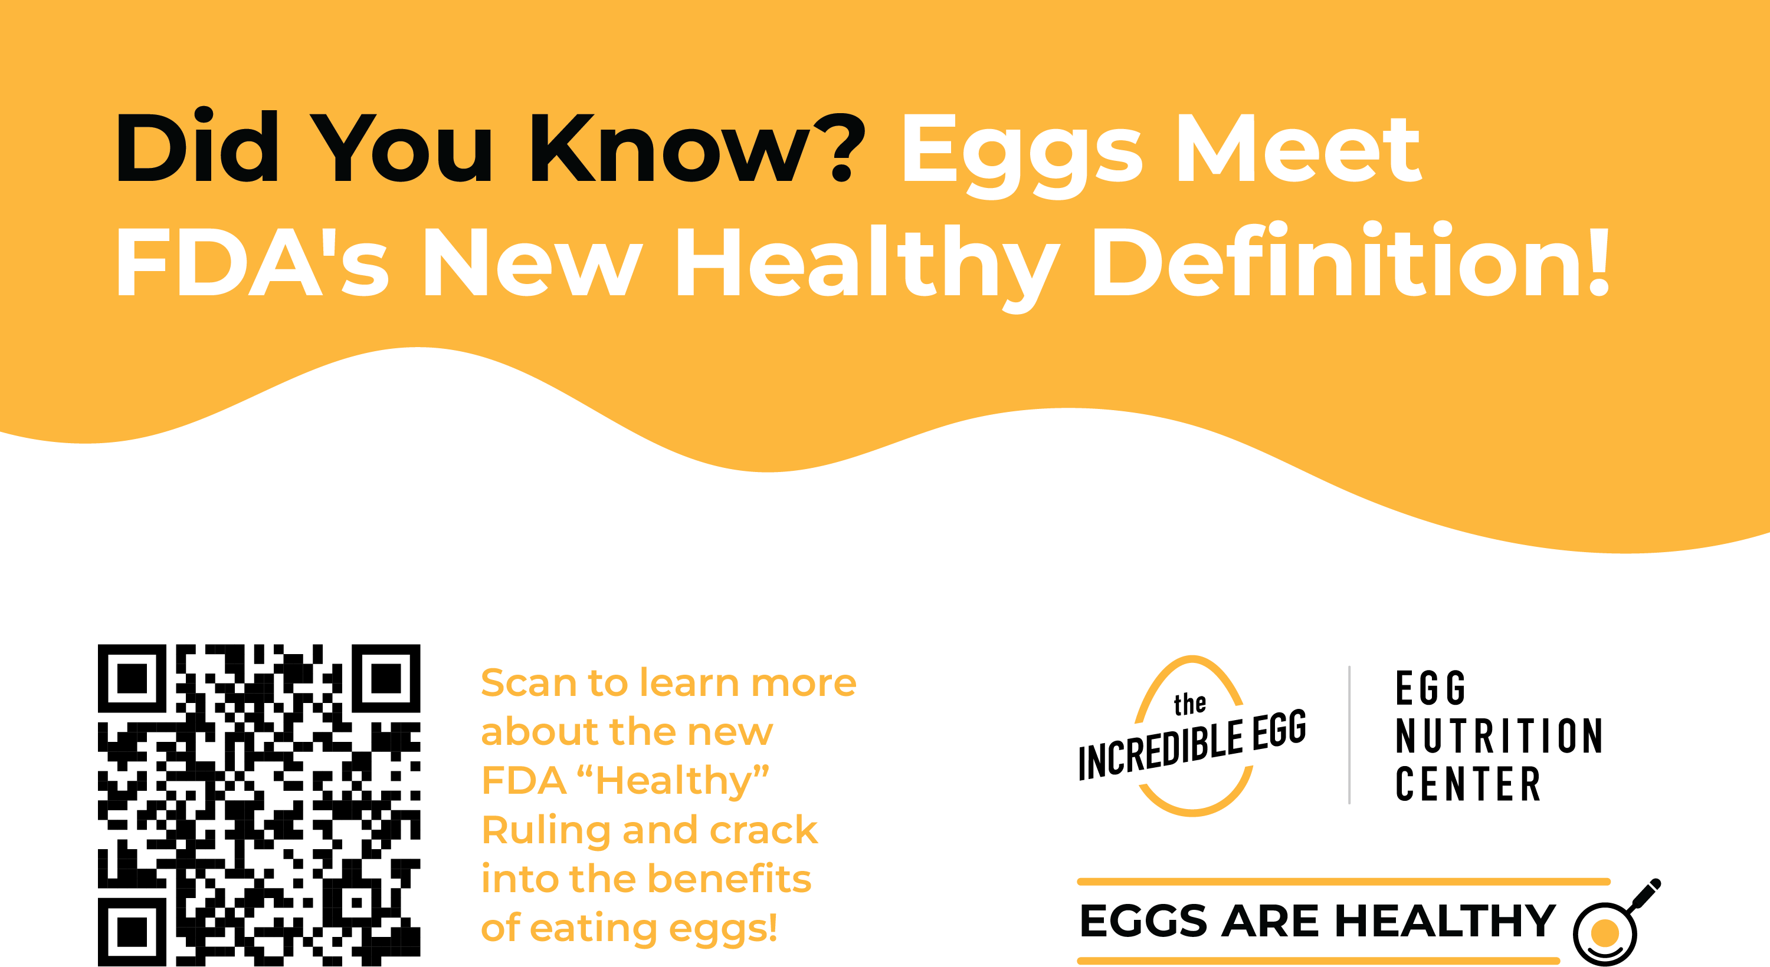
Resources to Share with Retailers
Downloadable In-Store Signage
The below signage is available and ready to be adapted for your needs. From resizing to reformatting or light customization, we’re equipped to support you.
Interested in in-store signage? Reach out to Katie Hayes at khayes@eggnutritioncenter.org for additional assistance.

Slide 17
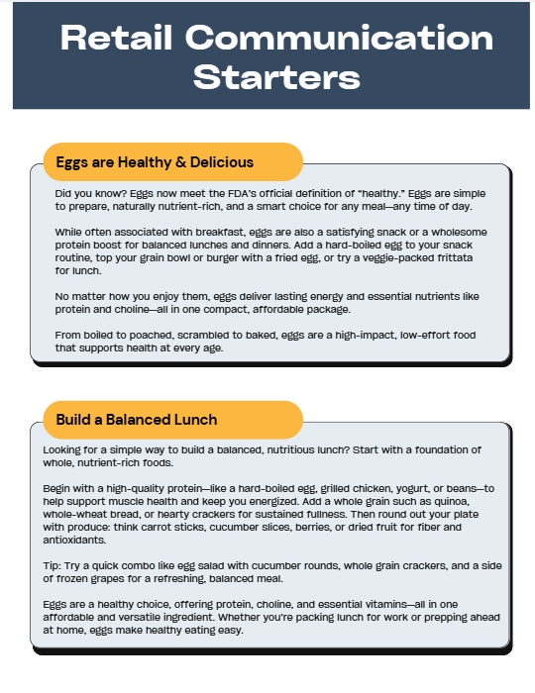

Resources to Share with Retailers
Guides to Drive Shopper Engagement
Communication Starters
for intercom announcements, radio spots, or circulars
Virtual Cooking Demo Guide

Slide 18
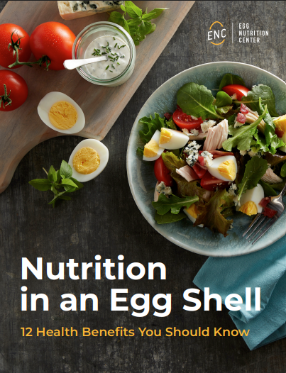
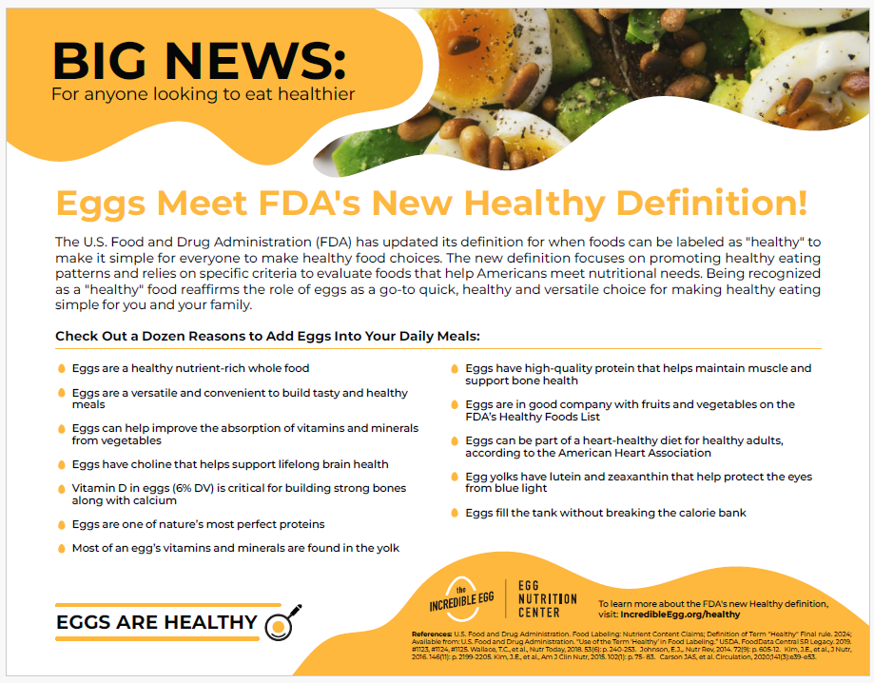
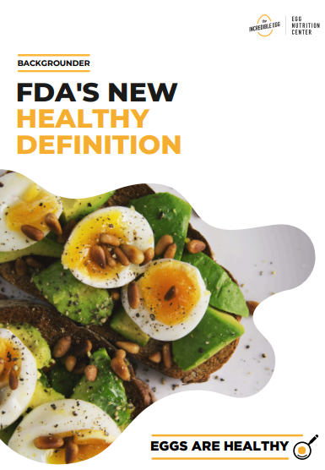
Resources to Share with Retailers
Educational Information
for newsletters, website articles, or 1:1 counseling appointments
Nutrition in an Egg Shell Handout
Dozen Reasons Why Eggs are Healthy Handout
Backgrounder

Slide 19
Digital
Ads

Slide 20
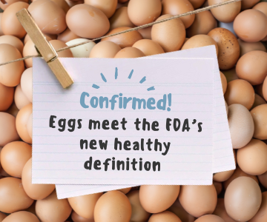
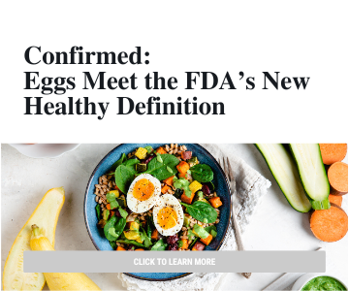
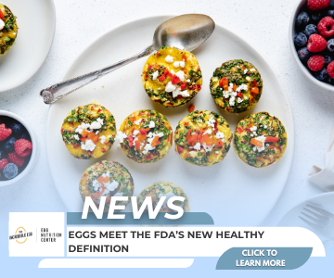
Digital Ads
The below creative is available and ready to be adapted for digital advertising. From resizing to reformatting or light customization, we’re equipped to support your media needs.

Slide 21
Thank You!
For any questions or assistance, please email:
Katie Hayes at KHayes@eggnutritioncenter.org

